Slide 2
Because you are here, I am taking a guess that some things are just not quite right in your life…
May be you are tired of your Job?
May be you can’t see yourself getting ahead with your current income?
May be the dreams are still not fulfilled?
May be the commute to work and rat race have forced you to start looking for alternate ways to make money?
May be you want to spend more time with your family?
Maybe there is a piece missing in your life?

Slide 3
Our objective is to introduce you to a system that’s proven, tested and has changed lives of millions of other people like you.
As you view this presentation, you will see there is a solution…
It is not for everyone.
However if you have the drive and the determination to make a change, we are convinced enough to say, you will not find a better opportunity available to you right now than BanSis Hub ….
Let us show you how you can free yourself from your 9-5 job and create a serious income all from the comforts of your own home.

Slide 4
Who We Are?
We are an International Direct Selling Company having Alliances and Channel partners all across the World. We are one of the fastest growing Companies in the Direct Marketing Industry today and are creating waves with our superb and revolutionary line of products meshed with a Global Business Opportunity.
Our turnkey Business system is the finest in the industry which has been
acclaimed and validated by Experts from around the globe.

Slide 5
Contact Information
Soudia Arab PathShala Global
Louki Akrita 14 (Registered Office)
Agiazoni, P.C. 3030
Limassol - EU
Yeman Lakeside House 1 Furzeground Way, Stockley Park Phone : +44.2033843830
Fascimile : +44.2033843831
Bangladesh Address: Shop no-228, 3rd floor, City Centre, Motijeel, Dhaka -1205
Phone : +91-124-3220640-49
Fax Number: +91-124-2396968
UAE
Corporate Office Pathshala Global
STC Senayan, 4th Floor # 69
Asia Afrika Pintu IX Gelora Senayan Phone : +62.2157931908 Fascimile : +62.2157932038
Company Email : info@pathshalaglobal.com Support Email : support@pathshalaglobal.com
KSA Email : ksa@pathshalaglobal.com UAE Email : use@pathshalaglobal.com
Upcoming Offices in : Turkey, Oman, Bahrain, Qatar

Slide 6
Our Vision
To be the No. 1 Global e-Commerce Company
by providing opportunities, instilling leadership,
creating millionaires and touching a billion hearts.
Our Mission
To inspire people to help others making a positive change in their lives.
One World, One Vision, One Family!

Slide 7
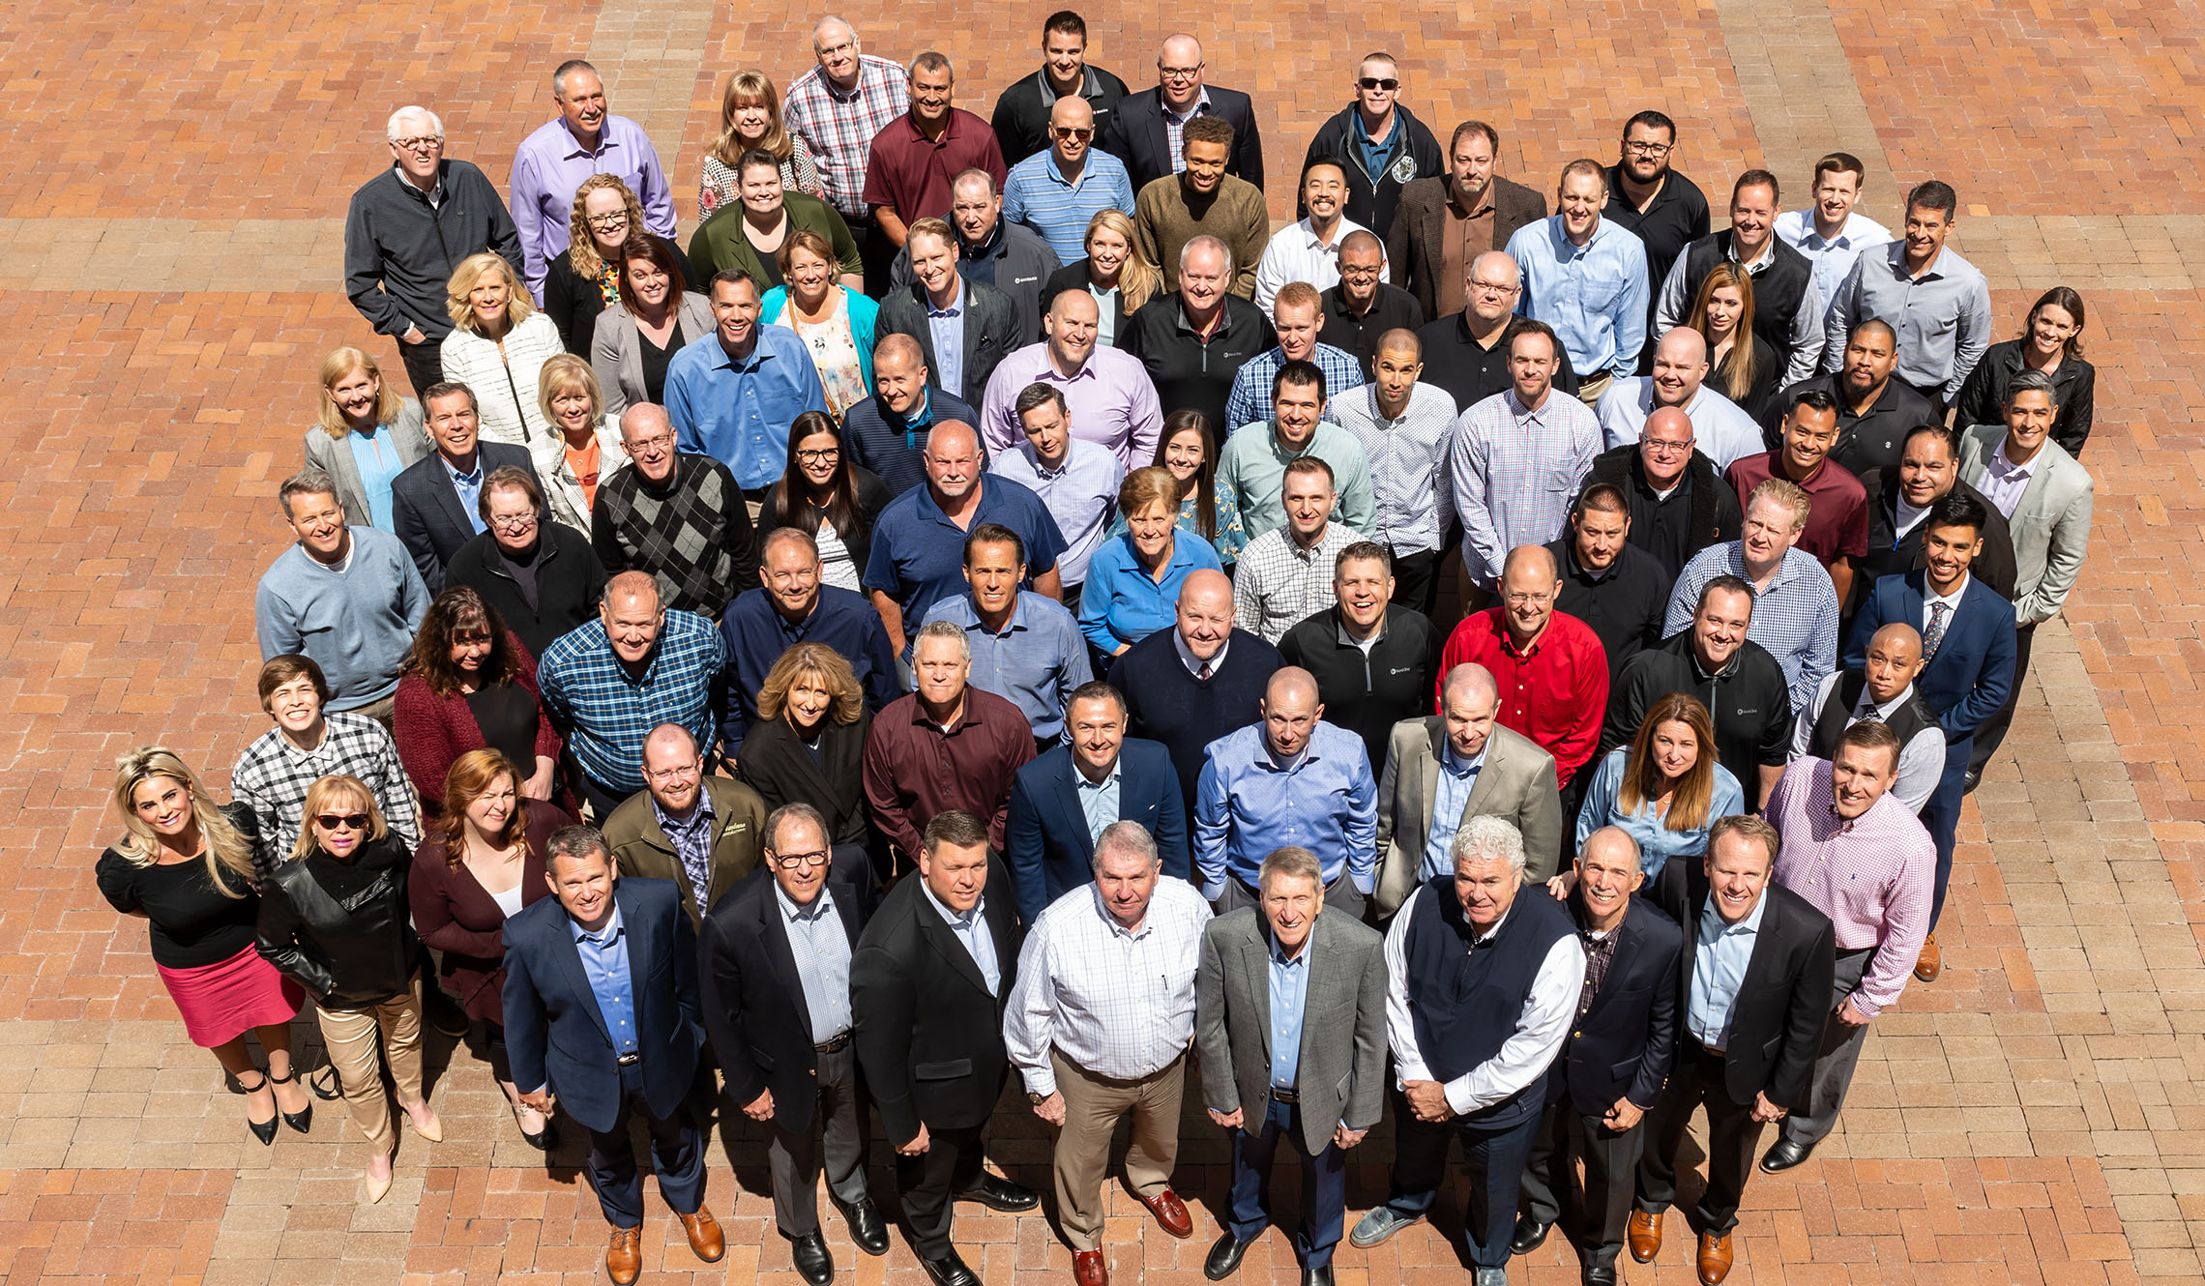
OUR BUSINESS PLAN
Go Final Destination!
The first milestone, formula for Financial Independence
To build the largest and strongest Associate Workforce in the World by training and educating our Associates from all over the world have basic understanding of how it works and have them follow some simple steps, over a consistent period of time.

Slide 8
Company Financial Backing
BanSis Hub is funded by a prestigious Business group having many
successful Businesses worldwide.
BanSis Hub is a pioneering effort of a successful team of Entrepreneurs having rich and diverse experience in many industries including Liabrary, products, fashion house, Saloon, Parlour, Travel and Tourism, Air Ticketing, Real Estate, Information Technology, Training with core experience in Direct Marketing.

Slide 9
BanSis Hub
Learn. Earn. Service
BanSis Hub is funded by a prestigious Business group having many successful Businesses worldwide BanSis Hub has combined the three most growing and popular trends today to form a business concept which leverages the power of each one of them.
bansishub.com is an educational multifaceted business organization. Learn, Earn & Service which is the only aim an objective.
A Person gets the following benefits with the purchase of bansishub.com Membership card.

Slide 10
The Three Megatrends
BanSis Hub has combined the three most growing and popular trends today to form a Business concept which leverages the power of each one of them.
Learn
Earn
Service

Slide 11
The BanSis Hub Advantage
BanSis Hub will help you have the best time of your life, take you to places which have existed only in your dreams till now, and give you an Opportunity to earn serious income day, after day, after day.
It doesn’t matter who you are, what you do or what your background is. Anybody in this World can succeed with BanSis Hub’s unrivalled Learn, Earn and service Program!

Slide 12
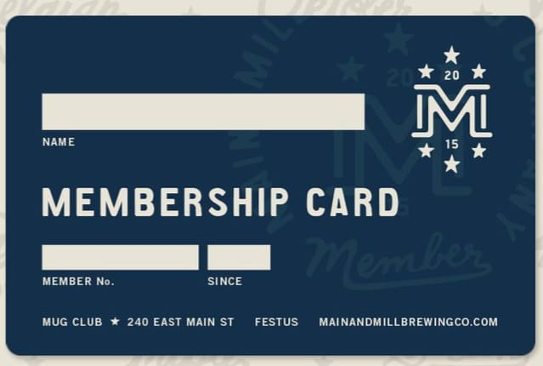
What Do You Receive
when you become a Distributor
Lifetime access to our upcoming promotional deals and programs
Free Self Replicating Website
Free access to high quality Business Tools
Virtual Office to manage your Business
And Much More…

Slide 13
Products And Services
Library
Products
Outlets
Ticketing
Travel and Tours
Medical Service
Courses & Training
Public Service
Wish Board
And Much More…

Slide 14
LIBRARY
You will become a Lifetime Member of BanSis Library upon acceptance of Membership. You can collect and read any book from our offline and online.
Online
Offline

Slide 15
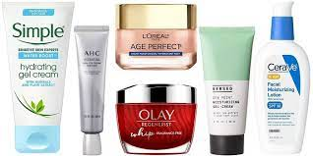
PRODUCTS
You will immediately get profit share (commission) from all products purchased.
Cosmetic Item
Food supliment

Slide 16
₃
₃
Products Sales Profit Share
The profit of each product sale 30% is paid to the sponsor and 20% is paid to the reference.
Profit 100% =
+ Refer 3%
Company Maintains 50%
+ Buyer 40%
+ Sponsor 7%

Slide 17
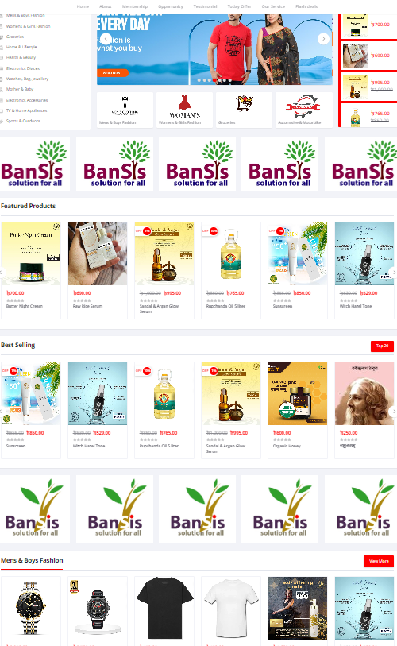
Products sales system
Fashion House
Diagnostic Centre
Gymnasium
Beauty Parlor & Saloon
Restaurant, Hotel & Fast Food
Residential Hotel & Resort
Coaching & Teaching Center

Slide 18
OUTLETS
Fashion House
Diagnostic Centre
Gymnasium
Beauty Parlor & Saloon
Restaurant, Hotel & Fast Food
Residential Hotel & Resort
Coaching & Teaching Center
All contracted banding establishments like Fashion Houses Diagnostic Centers, Gymnasium, Beauty Parlor, Salon, Restaurant, Residential Hotel, Resort, The coaching center will provide a certain amount of discount or rebate. That is, whatever you buy from our select shops, you will get 5-35% discount.

Slide 19
TICKETING
Only the Cardholder Person buys Air Tickets to any country in the world Earn fixed commission on every ticket profit.
Air Ticket
Train Ticket
Bus Ticket

Slide 20
TRAVEL AND TOURS
A REAL PRODUCT NEED
Products deals are a real need in the marketplace. The best product in the world is useless if it’s not in demand.
With emerging economies and changing lifestyles of people worldwide, Travel Industry shows no sign of slowing down, and is bound to go beyond the horizons.
Everybody is looking to save money on their Vacations and Business Trips. You can reap profits by giving them what they need.
If only cardholder person travel and travels, each pay commission along with travel and tours.
Domestic tour, International tour, Hajj and Umrah tour.

Slide 21
MEDICAL SERVICE
Hijama
Khatna
Spa
Body Check Up
Doctors Chamber
Blood Bank

Slide 22
COURSES AND SERVICES
Only Cardholder Person Computer, Outsourcing, Freelancing, Graphics, Video Editing, Get discount or commission on all courses including Basic Training.
Basic Computer
Outsourcing
Freelancing
Graphics
Vedio Editing
Basic Training

Slide 23
Membership PRICING
How much are these worth?
Valued at thousands of dollars, BanSis Hub’s unrivalled “Learn, Earn and service” Package is available to you
ONE-TIME COST OF 999
PREMIUM PACKAGE
for only COIN 999
24/7 Account access.
Free Replicating Website.
Virtual office.
Access to high quality
business tools.
And that’s not all..
BanSis Hub also provides you a Global Business Opportunity to create a solid income pipeline for you and your family .
And a lot More
Read on to know further...

Slide 24
For those of you who are interested in supplementing your income by telling others about BanSis Hub’s product and services, please continue with the PowerPoint Presentation to learn more about the BanSis Hub Business Opportunity.
How Do You Earn Money?
We offer one of the Strongest Compensations plans in the Industry with Multiple Ways to Earn
Daily, Weekly and Monthly Income!

Slide 25
Compensation Plan
1. Matrix System (Scholarship)
2. Refer Profit
3. Products Sales Profit Share
4. Incentive
5. Discount Income

Slide 26
₁
Matrix System (Scholarship)
All Team members make their way to the top of Compensation plan through Matrix system which makes you upto 6, 100, 500, 10,000, 1,00,000 Scholarship Coin. This system ensures your success and helps you to capitalize on the efforts of all team members present in the Class.
The system consists of following Five Class:
1. Primary Class
2. Junior Class
3. Senior Class
4. Higher Class
5. Final Class
–Sales
–Points
–Points
–Points
–Points
Here’s how it works…

Slide 27
Sample Movement Through Class
You were introduced by Adam
You introduce Nuh and Jacob
Nuh
YOU
Jacob
Adam

Slide 28
Primary Class
When the Class fills up, 1 position moves to Junior Class
and earns a startup 6 Scholarship Coin.
03
02
15
04
14
05
13
01
06
12
07
11
08
10
09
Enter Here
Qualified Participants from Primary Class advance to a 8 to 15 Positions on to the Junior Class

Slide 29
Primary Class
Position 1 → 2 → 3 → 4 → 5 → 6 → 7 → 8 → 9 → 10 → 11 → 12 → 13 → 14 → 15
New members are introduced by existing members on Primary Class
Mary
Tony
Harry
Sue
YOU
Dan
Sue
Meli
Jil
Greg
Dan
Tony
Helen
Linda
Adam
Joe
Harry
Mary
Helen
Adam
Linda
Peter
Jacob
Greg
YOU
Nuh
Jil
Nuh
Jacob
New Members Enter position 8 to 15 positions

Slide 30
When position 8 to 15 is filled 2 NEW Class are formed with a NEW row of 8 to 15 positions under each NEW Class
Joe enters the Junior Class earning 6 Scholarship Coin
Mary
Tony
Jil
Harry
Sue
YOU
Dan
New Class #1 – 1 to 7 positions
Sue
Meli
Greg
New Class #2 – 1 to 7 positions
Dan
Tony
Helen
Adam
Step1: System looks for Members with 2 sales and places them in order from level 2 to level 15, left to right.
Linda
Joe
Harry
Mary
Helen
Linda
Adam
Step2: System looks for Members with 1 sale and places them in order from level 2 to level 15, left to right.
Peter
Greg
Jacob
Step3: System looks for Members with NO sales and places them in order from level 2 to level 15, left to right.
YOU
Jil
Nuh
Nuh
Jacob

Slide 31
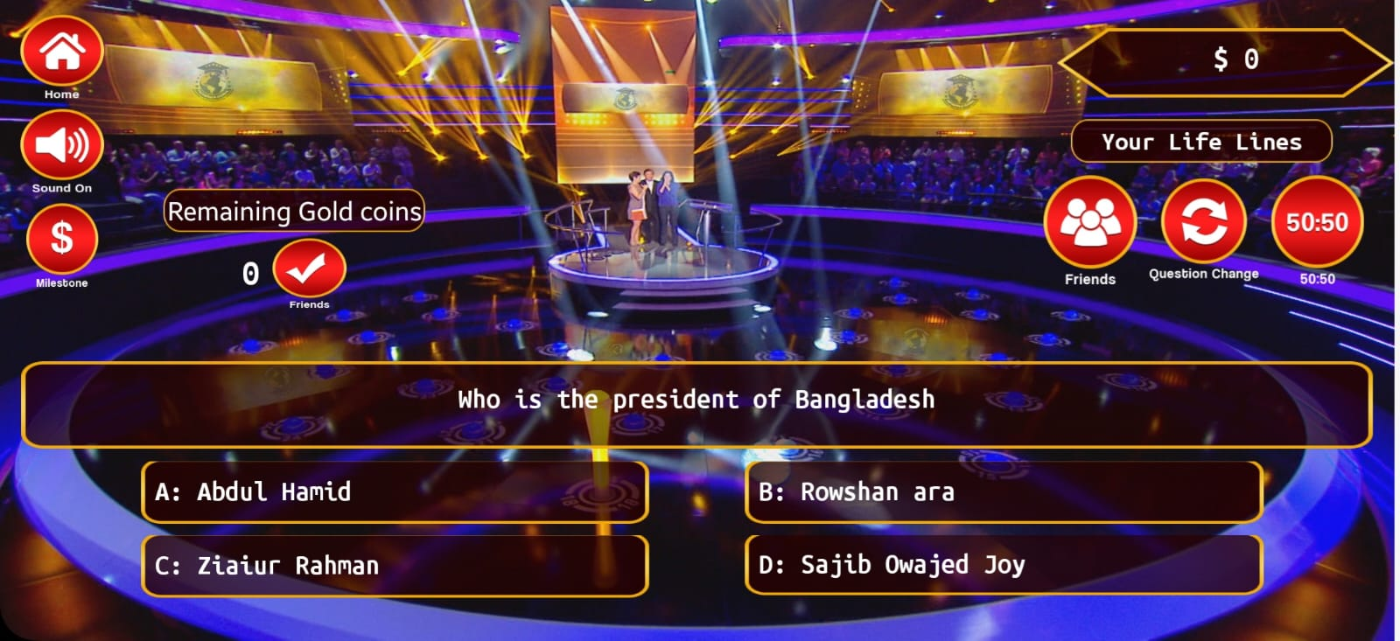
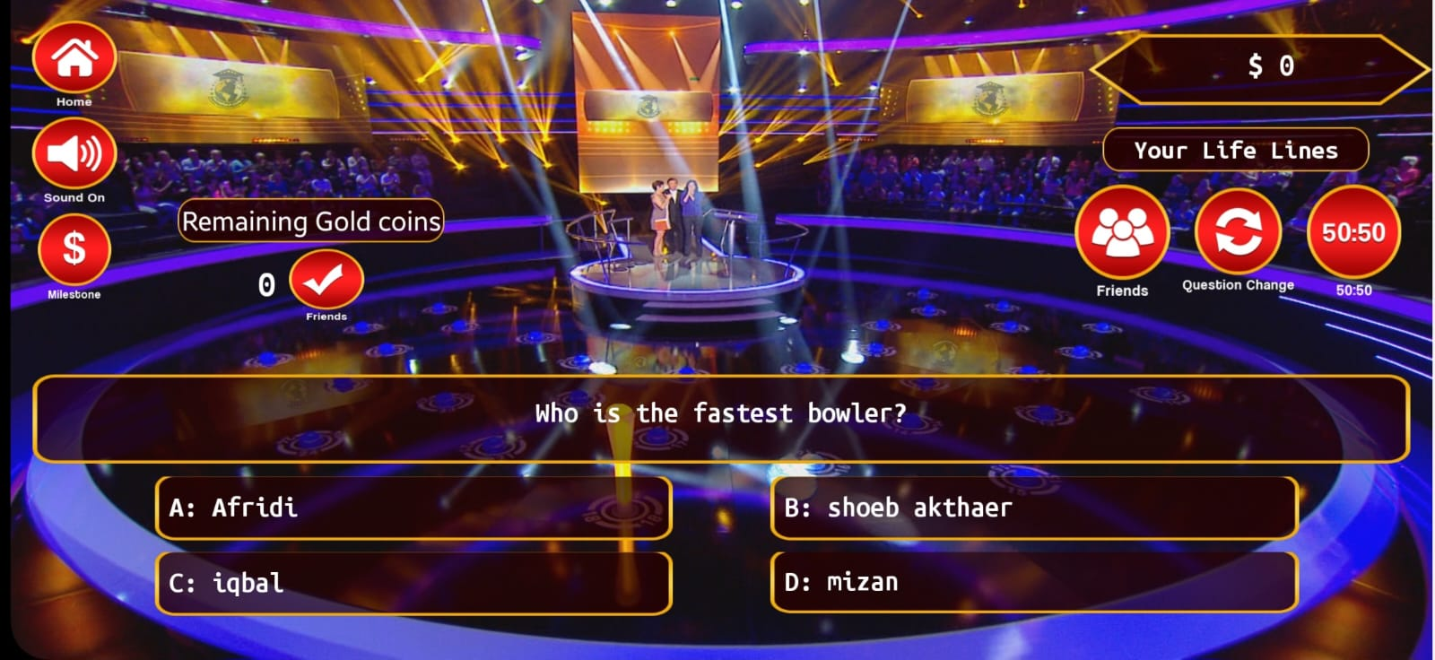
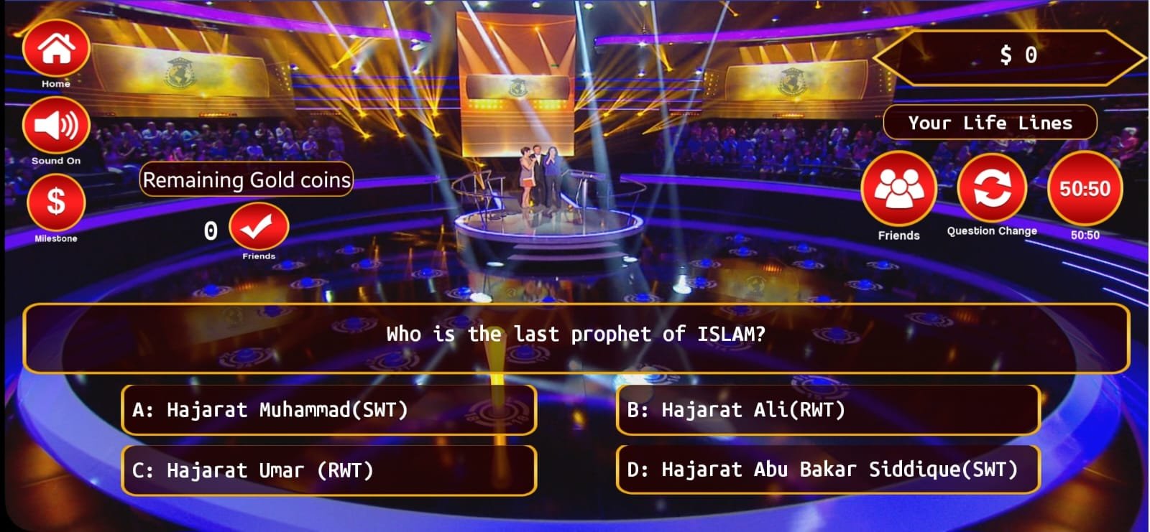
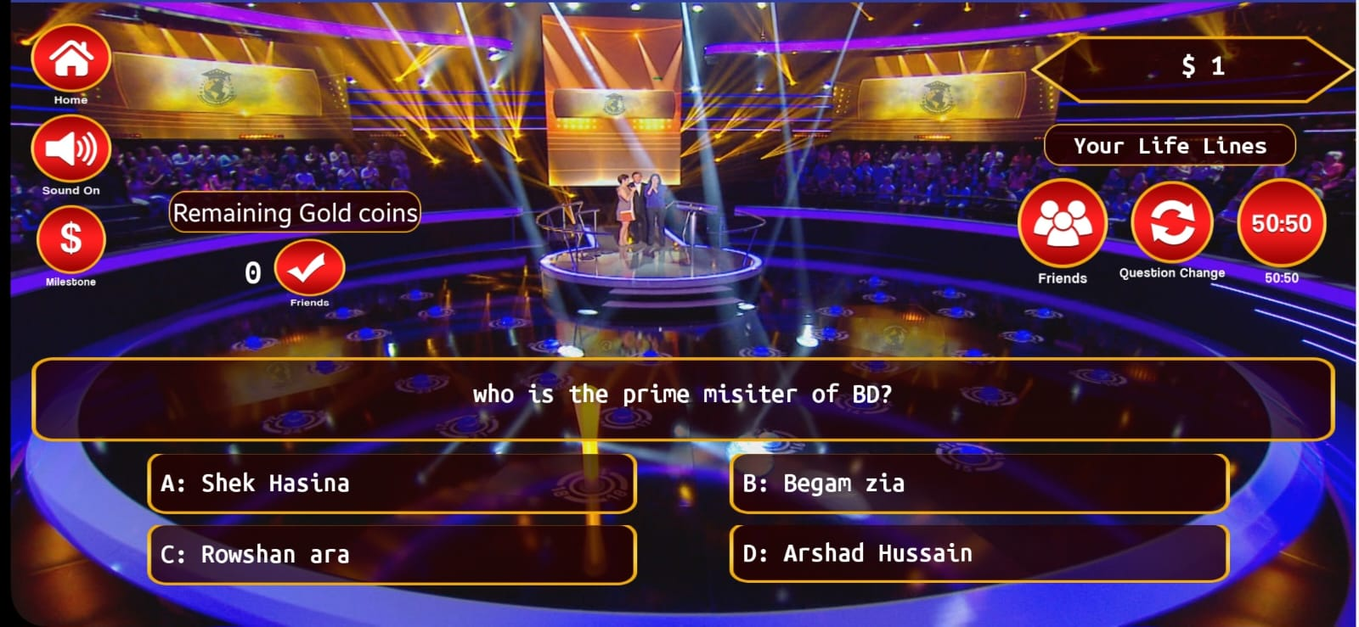
Learn from Apps
earn to learn to learn
Your point Count will start from when you enter Junior Class.
Quiz Points

Slide 32
Points Calculation
earn to learn to learn
Your point count will start from when you enter Junior Class.
Quiz Point
Welcome Points
Sponsor Point
Refer Point
Scholarship Point
Purchase Point
Library Point
Products Buy Point
Air Ticketing Buy Point
Travel and Tours
Medical Service
Courses & Training
Public Service
Wish Board
And Much More…

Slide 33
Junior Class
100 Scholarship coin credited to your Online Wallet instantly
one time you pass; entry to the Senior Class
The successful Member enters from Junior Class to Senior Class at 1 position with Scholarship Coin 100
03
02
15
04
14
05
13
01
06
12
07
11
08
10
09
Enter Here
Qualified Participants from Primary Class advance to a Position 01 on to the Junior Class

Slide 34
Junior Class
Position 1 → 2 → 3 → 4 → 5 → 6 → 7 → 8 → 9 → 10 → 11 → 12 → 13 → 14 → 15
Trish Receives 100 Scholarship Coin go to the Junior Class to Senior Class out following the same system.
Member entering Junior Class follow their uplines on the Junior Class
Ron
Harry
Ken
950
1000
350
Sam
Gary
800
650
Kate
900
Trish
Mike
400
1000
Bob
Tom
750
450
Paul
Ben
700
500
Joe
850
Nayan
Matt
600
550
New Qualified Members from Primary Class to Junior Class Enter Level 8

Slide 35
When Level 8-15 is filled 2 NEW Class are formed with a NEW row of 8-15 positions under each NEW Class
Step 1: Trish enters the Senior Class earning 100 Scholarship Coin
Rom
950
Harry
1000
Ken
350
New Class #1 – 1 to 7 positions
Sam
800
Gary
650
New Class #2 – 1 to 7 positions
Kate
900
Mike
400
Trish
1000
Bob
750
Step 2: System looks for Members with highest to lowest points and places them in order from level 2 to15, new class 1 and 2 of left to right.
Tom
450
Paul
700
Ben
500
Joe
850
Nayan
600
Matt
550

Slide 36
Primary Class
Primary Education Certificate (PEC)
When you pass from Primary Class to Junior Class then you will become Primary Associate. You will be issued with a Primary Education Certificate (PEC) along with 6 Coins for Scholarship or equivalent educational material.
Primary Class Scholarship : Coin 6

Slide 37
Junior Class
Junior Education Certificate (JEC)
When you pass Junior Class and go to Senior Class then you will become Junior Associate. You will be awarded a Junior Education Certificate (JEC) along With 100 Coins for Scholarship or equivalent Tour Package or Exclusive Mobile.
Junior Class Scholarship : Coin 100

Slide 38
Senior Class
Senior Education Certificate (SEC)
When you pass from Senior Class to Higher Class then you will be Senior Associate. You will be awarded a Senior Education Certificate (SEC) and you will also be awarded a Scholarship of 500 coins or an Exclusive Laptop of equivalent amount.
Senior Class Scholarship : Coin 500

Slide 39
Higher Class
Higher Education Certificate (HEC)
When you pass Higher Class and go to Final Class then you will be Higher Associate. You will be awarded a Higher Education Certificate (HEC) along with a Scholarship of 10000 Coins or an Exclusive Bike of equivalent amount.
Higher Class Scholarship : Coin 10000

Slide 40
Final Class
Final Education Certificate (FEC)
You will be Final Associate when you pass Final Class and complete Mission. You will be awarded a Final Education Certificate (FEC) along with a scholarship of 1,00,000 coins or a luxury car or luxury House of equivalent amount.
Final Class Scholarship : Coin 100000

Slide 41
Rank Progress and Coin Structure
Following is the chart of different leadership ranks and coin involved with them:
Primary Associate :Scholarship Coin 6 or Magic Box
Junior Associate :Scholarship Coin 100 or Tour Package
Senior Associate :Scholarship Coin 500 or Exclusive Laptop
Higher Associate :Scholarship Coin 10,000 or Exclusive Bike
Final Associate :Scholarship Coin 1,00,000 or Luxury Car Or Luxury House
Note : Final Associate get a share in the Company’s Global Profits by participating in the Power Pool

Slide 42
Leadership Ranks
At BanSis Hub, you achieve various ranks as you advance through the Compensation Plan creating a legacy income for yourself.

Slide 43
Follow The Leader
Follow-the-Leader system ensures that your Class move as fast as you want by sponsoring maximum number of people that you can. All your downlines will be connected to you and will always follow you whichever Class you move to.
Spillover System
Spillovers help you succeed even if you are unable to make 2 sales by connecting extra sales of qualified candidates to non-qualified members. This ensures your success with a team support and helps you move from Primary to Junior, Junior to Senior, Senior to Higher, Higher to Final Class within no time.
Spill By Will
In Spillover the placement of the spill is decided by the system via a standard scan which runs from highest to lowest & left to right and the spill joins the original sponsor’s Class by default. However, Spill by Will is a revolutionary feature which when activated for a specific number of entries enables the sponsor to decide both the placement of the spill as well the class of the joining. By activating this feature, the sponsor or the group leader can decide the movement of the Class.
Note : You need to be a qualified member in the Primary Class or should be in Junior Class to activate "Spill by Will". If Spill by Will is not activated, Spill Over stays active as the default system.
Jump over System
Jump-Over system allows ID’s that have made their 2 sales to jump to the top of the Class, if there are no qualified ID’s above them with 2 sales. Jump Over allows active members to have preference over inactive ones. We have not left any stone unturned to value those who are dedicated to the Business and have that zeal within to reach the Highest.

Slide 44
₂
Refer Profit
BanSis Hub’s compensation plan has been designed to give you regular income day after day. The revolutionary matrix system not
only creates a long term income Opportunity for you but also helps you
earn enormous amount of income every single with growth of your organization.
10% Referal profit will be given on every sales.

Slide 45
₃
₃
Products Sales Profit Share
The profit of each product sale 30% is paid to the sponsor and 20% is paid to the reference.
Profit 100% = Company Maintains 50%
+
Sponsor 30%
+
Refer 20%

Slide 46
₄
₃
Discount Income
Library
Products
Outlets
Air Ticketing
Travel and Tours
Medical Service
Courses & Training
Public Service
Magic Board

Slide 47
₃
₅
Incentive
Agent:-
New Member:-
Primary Associate:-
Associate:-

Slide 48
In Business Timing Is Everything
Right Place
Right Time
Right Platform
Right Decision
With BanSis Hub, the timing is perfect.
“The poor, the unsuccessful, the unhappy, the unhealthy are the ones who use the word "tomorrow" the most. Smart people don’t work for money, they just do things which other people delay doing”
-- Robert Kiyosaki

Slide 49
Why You Should Join BanSis Hub?
Stable, debt free Company
Solid Backing by a successful and established Business Group
Universal Line of Products
Opportunity to build a Global Business from home
Unmatched Compensation Plan
Worldwide Recognition
Strong Presence in many countries with continuous expansion plans in pipeline.
Fast income with earnings at every step .

Slide 50
How Do You Get Started?
You have two very simple choices!

Slide 51
Immediately get back to the person who referred you to the website
or sent this presentation to you and ask the sign up process
Alternatively, you can visit www.bansishub.com and Click on “Join Now” which will take you through three simple steps to have you start earning money within minutes!
It’s as simple as that.

Slide 52
Dreams Are Becoming Reality
Where Do You See Yourself?
1
2
3
Join Us Today
Undergo Basic Training
Get on the way
to success!

Slide 53
will become
a household name soon
What % of the global market
do you want ?
Be a part of the moment
Take Action…
Today!

